Slide 1
IPv4 to IPv6
By TEAM AMBASSADOR

Slide 2
Table of Contents
01
02
03
04
What is IP
Describe What is IP, Why it’s needed.
What is our motivation
We’ll discussing our motivation for this project.
Our Process and workflow
We’ll show the project workflow.
Conclusion
Q&A , and Project live view

Slide 3
TEAM AMBASSADOR
Mohammad Nazmul Hossain
ID - 193902031
Jonaed Hasan
ID - 193902029

Slide 4
01
What is IP?

Slide 5

Internet Protocol version 4
IP stands for Internet Protocol and v4 stands for Version Four (IPv4). IPv4 was the primary version brought into action for production within the ARPANET in 1983.
IP version four addresses are 32-bit integers which will be expressed in decimal notation.
Example- 192.0.2.126 could be an IPv4 address.

Slide 6



What’s the Difference?
IPv4
IPv6

Slide 7
02
motivation

Slide 8

—Reason behind it.
“Although many devices do not support IPv6 despite IPv6's arrival, we will do this shortly so they can be used on IPv6-enabled devices..”

Slide 9
4,300,000,000
340 trillion
In IPv4
There are 2^128 or 340 trillion, trillion, trillion IPv6 addresses

Slide 10
Workflow

Slide 11
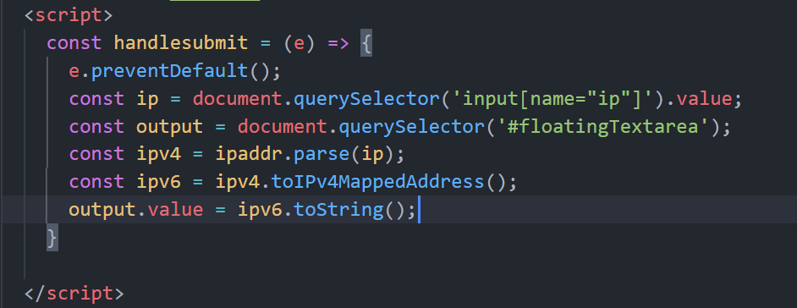
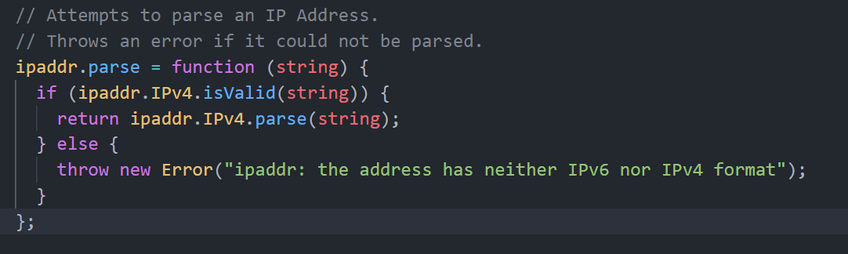

Slide 12
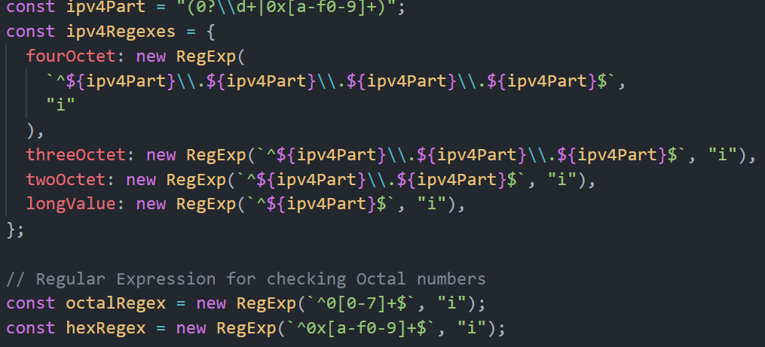
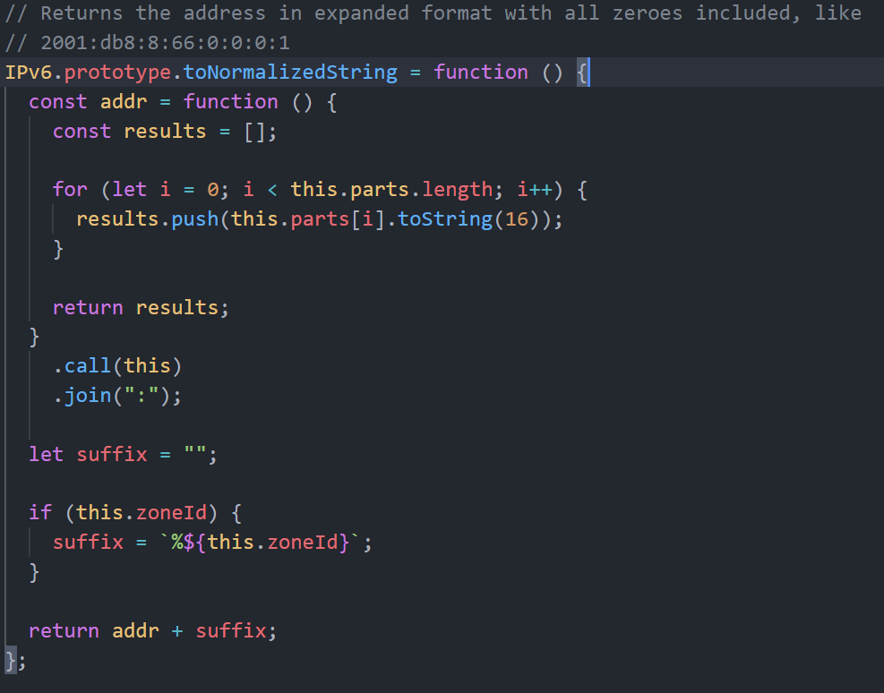

Slide 13
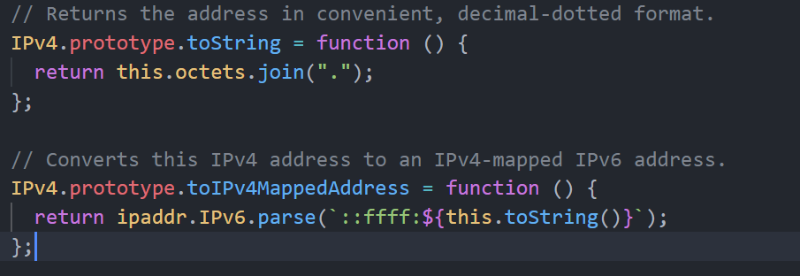

Slide 14
Live view
Now we are presenting our project .

Slide 15
Live preview

Slide 16
Thanks!
Do you have any Questions?
All right received by @TEAM AMBASSADOR

